Slide 1
17
Session 17 of 24
Forests, boosting and overfitting
How do we get a stronger model without fooling ourselves?
Jotham Martin Wambi, KLAi Professional Learning
Session 17 Forests, boosting and overfitting
1
Notes:
Seventeen sessions in, and today's question is how to get a stronger model without fooling ourselves. Last session you learned to judge a model and to catch a column that leaks the answer. We start with a curve from Lakeside Mart weekly orders that shows what overfitting looks like. Then come forests and boosting on the Nile Microfinance loans, cross-validation to tune them, and feature importance read with care. The question at the end is a business one. When two models score about the same, which would you ship?

Slide 2
By the end of today
How the two hours run
Explain bias, variance and overfitting from a curve.
Recall and warm-up
10 min
Concepts and explanation
30 min
Fit a forest and a boosted model.
Live demonstration
25 min
Read feature importance without over-claiming.
Break
5 min
Guided lab
40 min
Check and wrap-up
10 min
Session 17 Forests, boosting and overfitting
2
Notes:
The ideas and the code are mixed together today, so you'll see each model run as soon as we meet it. By the end you can explain overfitting, bias and variance from a curve. You can fit a random forest and a gradient boosting model on the loans and tune a few settings with cross-validation. You can read feature importance without claiming more than it shows. The lab ends with a table of train and test scores and one sentence on which model you would ship.

Slide 3
Vocabulary
Word | Plain meaning | In a spreadsheet
Overfitting | A model that fits the data it studied very well and does worse on new data. | A trendline with so many bends it passes through every dot
Bias and variance | Bias is error from a model too simple to see the pattern. Variance is error from a model so wiggly it follows the noise. | No equivalent. A new idea.
Bagging | Training many models on random resamples of the data and averaging their answers. | Asking twenty colleagues for a forecast and averaging
Random forest | Bagging applied to decision trees, each seeing a few columns at a time. | A committee of many different trees voting
Boosting | Adding small trees one after another, each aimed at the mistakes of the ones before. | A new column that corrects the errors in the last column
Hyperparameter | A setting you choose before the model learns, such as the depth of a tree. | The number of periods in a moving average
Permutation importance | The drop in score when one column is shuffled, used to see which columns a model relies on. | Blank out one column and see how much the forecast gets worse
Session 17 Forests, boosting and overfitting
3
Notes:
Seven words today. Overfitting is a trendline with so many bends that it passes through every dot. Bias and variance are the two ways to get a model wrong, too simple or too wiggly. Bagging, short for bootstrap aggregating, averages many models trained on resamples. A random forest is bagging applied to decision trees. Boosting adds small trees one after another, each fixing the last one's mistakes. A hyperparameter is a setting you choose before learning, like the periods in a moving average. Permutation importance shuffles one column to see how much the score drops.

Slide 4
Warm-up from Session 16
1
A loan model scored an AUC near 0.995 once a single column was added. What did that column do?
collection_calls is recorded only after a loan goes bad, so it leaks the answer.
2
Why cross-validate instead of trusting one train and test split?
Five different test parts give five scores. Their average depends less on luck.
Session 17 Forests, boosting and overfitting
4
Notes:
Leakage and cross-validation first. Two questions from last session.
First. A loan model scored an AUC near zero point nine nine five once one column was added. What did that column do? Have a think.
The column was collection_calls. A lender only makes collection calls after a loan has gone bad, so the column holds the answer inside it. That is leakage, and it's why we removed it.
Second. Why cross-validate instead of trusting a single train and test split? No rush.
One split can be lucky or unlucky. Cross-validation gives every part of the data a turn as the test part, so you get five scores and you average them. Today you'll use that same idea to pick settings for a stronger model.

Slide 5
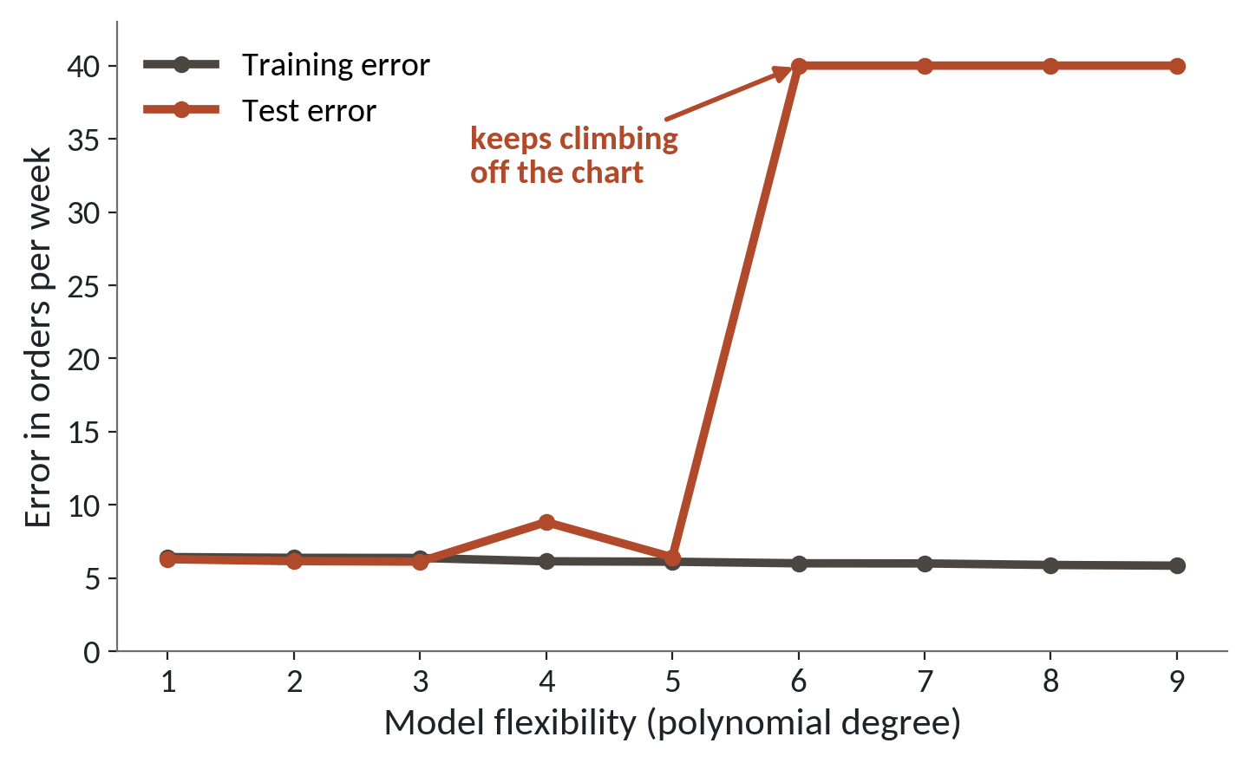
A curve with too many bends fails on new weeks
1
Training error sits near 6 orders a week at every degree.
2
Test error stays near 6 up to degree 5, apart from a small bump at degree 4.
3
From degree 6 the test error shoots off the chart.
Weekly orders at the Jinja branch against footfall. 35 weeks to learn from, 69 weeks held back to test.
Session 17 Forests, boosting and overfitting
5
Notes:
We start with a picture from data you know. It's the weekly orders at the Jinja branch of Lakeside Mart, predicted from footfall, which is the number of people through the door.
In Excel you can add a trendline to a scatter chart and choose polynomial, then pick an order. Order one is a straight line. Each higher order adds one more bend. On the bottom of this chart, that's the degree. More degree means a more flexible curve.
We fitted each curve on thirty five weeks, then measured the error in orders per week on those same weeks. That's the dark line. It stays near six all the way across. The fit to the old weeks barely changes.
The red line is the error on sixty nine weeks the curve never saw. Up to degree five it stays close to the blue line, also near six, with one small bump at degree four.
Then at degree six it shoots off the top of the chart. The curve has stopped learning the pattern and started following the quirks of those thirty five weeks. That is overfitting.

Slide 6
Train error and test error for five curves
import numpy as np
import pandas as pd
bw = pd.read_csv('branch_weeks.csv')
g = bw[bw.branch_id == 'B04']
f = g.footfall.values
x, y = (f - f.mean()) / f.std(ddof=1), g.orders.values
idx = np.random.default_rng(2).permutation(104)
tr, te = idx[:35], idx[35:]
def rmse(i): return round(np.sqrt(np.mean(r[i] ** 2)), 1)
for d in [1, 3, 5, 6, 9]:
r = np.polyval(np.polyfit(x[tr], y[tr], d), x) - y
print(d, rmse(tr), rmse(te))
1
Learn from 35 weeks and hold the other 69 back for testing.
2
polyfit draws a curve with d bends through the training weeks.
3
Error is how far off we are, in orders per week, on each part.
Output
5 6.1 6.4
6 6.0 72.4
9 5.9 25053.4
Session 17 Forests, boosting and overfitting
6
Notes:
Here's the code behind that chart, so you can see there's no trick. It's only numpy and the Jinja weeks.
First we split the weeks. Thirty five go in the learning part, called tr, and the other sixty nine go in the test part, called te. The random generator has a fixed seed, so you'll get the same split I do.
Then a loop tries five degrees. polyfit draws a curve of that degree through the learning weeks only.
Last, we measure the typical miss, in orders per week, on each part, with the learning weeks first and the test weeks second. Read the output. At degree one the miss is about six on both parts. At degree six, the learning miss is still six, but the test miss is seventy two. At degree nine it's over twenty five thousand. A model can look perfect on the weeks it studied and be useless on next week.

Slide 7
Too simple and too wiggly are both wrong
Too simple (bias)
Too wiggly (variance)
Misses the real pattern
Follows the noise in the data
Wrong on old data and on new data
Right on old data, wrong on new data
One flat average for every loan
A special rule for every borrower
Aim for the middle: flexible enough to see the pattern, plain enough to hold up on new loans.
Session 17 Forests, boosting and overfitting
7
Notes:
Two words come up in every machine learning conversation, bias and variance. Here they are in plain speech.
A model that's too simple has high bias. It's a straight line through a curved cloud, or one average used for every loan. It misses the real pattern, so it's wrong on the old data and wrong on the new data.
A model that's too wiggly has high variance. Imagine a rule for every single borrower, including the odd ones. It follows the noise. On the old data it looks brilliant. On new loans it falls apart, like the degree six curve we just saw.
So the goal sits in the middle. Flexible enough to see the real pattern, plain enough to hold up on loans it has never met. Every setting we tune today is a way of sliding along that line between the two.

Slide 8
Get the loans ready, leaving out the leak
import pandas as pd
loans = pd.read_csv('loans.csv')
age = loans.age
loans['age'] = age.where(age.between(18, 90), age.median())
inc = loans.monthly_income_ugx
loans['monthly_income_ugx'] = inc.fillna(inc.median())
loans['burden'] = (loans.loan_amount_ugx / loans.term_months
/ loans.monthly_income_ugx)
X = loans.drop(columns=['default', 'collection_calls'])
X = X.select_dtypes('number')
y = loans['default']
print(X.shape)
print(y.sum(), len(y))
1
Mend the impossible ages and the blank incomes.
2
burden is the monthly instalment divided by monthly income.
3
Keep the number columns. collection_calls is left out.
Output
(8000, 11)
1004 8000
Session 17 Forests, boosting and overfitting
8
Notes:
The loans come next. We load the Nile Microfinance file and get it ready, using only pandas, which you know.
Two ages in this file are impossible, one is zero and one is a hundred and ninety nine. We replace anything outside eighteen to ninety with the median age. The blank incomes get the median income. Then we make one new column, burden. It's the monthly instalment divided by monthly income, ignoring interest to keep it simple. A loan that eats a big share of someone's income is riskier.
We keep the number columns as our features, eleven of them, after dropping the answer column and collection_calls. We removed it last session because it leaks the answer.
The output says eight thousand loans and eleven columns. And a thousand and four defaulted out of eight thousand, which is about one loan in eight.

Slide 9
A forest is many different trees asked to vote
Resample
Grow a tree
Repeat
Vote
Draw a random sample of loans, with repeats.
It sees that sample, and a few columns at each question.
Hundreds of trees, each a little different.
Average their answers into one probability.
Averaging many wiggly trees cancels out the wiggles. This is bagging.
Session 17 Forests, boosting and overfitting
9
Notes:
In Session 15 you met the decision tree, a set of yes and no questions. One deep tree is very wiggly. It memorises. A forest fixes that by asking many trees and taking the vote. It works like asking twenty colleagues for a forecast and averaging their answers.
Step one. Resample. This is the bootstrap idea from Session 12. We draw a random sample of the loans, with repeats allowed, so each tree gets a slightly different version of the data.
Step two. Grow a tree on that sample. At each question it only looks at a few of the columns, picked at random, so the trees don't all copy each other.
Step three. Repeat, a few hundred times. Every tree is a little different.
Step four. Vote. The forest averages the trees' answers into one probability of default.
The resample and average trick has a name, bagging. It's short for bootstrap aggregating. A random forest is bagging applied to decision trees. Each tree is wiggly, but their mistakes point in different directions, so the average is steadier.

Slide 10
Fit a random forest on the loans
from sklearn.model_selection import train_test_split
from sklearn.ensemble import RandomForestClassifier
from sklearn.metrics import roc_auc_score
X_train, X_test, y_train, y_test = train_test_split(
X, y, test_size=0.25, stratify=y, random_state=42)
forest = RandomForestClassifier(n_estimators=200, random_state=42)
forest.fit(X_train, y_train)
p = forest.predict_proba(X_test)[:, 1]
print(roc_auc_score(y_test, p))
1
stratify keeps the same share of defaults in both parts.
2
200 trees. random_state fixes the dice so you can repeat the run.
3
predict_proba gives a probability. Column 1 is default.
Session 17 Forests, boosting and overfitting
10
Notes:
Here's a forest in scikit-learn. The pattern is the one you know, split, fit, predict.
First we split the loans, a quarter held back for testing. The word stratify keeps the share of defaults the same in both parts. That matters when only one loan in eight defaults. The seed of forty two makes the split repeatable.
Next we make the forest with two hundred trees and fit it on the learning part. Same fit call as every model you've built.
Then predict_proba gives a probability for each test loan, and we keep column one, the chance of default. The last line scores it with AUC.
In a typical run a forest scores an AUC a little above the logistic regression, around zero point seven six to zero point eight. Your own number will be close to that but won't be identical. Read your own output, and write it down. You'll need it for the lab.

Slide 11
A near perfect score on the training loans
What it looks like
Why it goes wrong
The fix
You fit a forest and score it on the same loans it learned from. The AUC is close to one. It runs with no error and looks like a triumph.
Deep trees can remember every training loan. The training score shows how well the model memorised, and says little about new borrowers.
Report the test score, and print the training score beside it. A large gap between the two is the warning sign.
Session 17 Forests, boosting and overfitting
11
Notes:
This trap can cost money, and it runs without a single error.
You fit the forest, then you score it on the same loans it learned from. The AUC comes out close to one. Perfect. You email your manager.
A deep tree can remember every loan it was shown, including the odd ones. Scoring it on those same loans is like marking a student with the exact questions they practised. The forest shows how good its memory is. It tells you very little about the next borrower to walk in.
Report the score on the test part, and print the training score right beside it. If training says point nine nine and test says point seven eight, that gap is your overfitting, measured. A small gap means the model is holding up.

Slide 12
Boosting: each tree repairs the last one's mistakes
Start simple
Start simple. A very small first tree, a rough guess.
Find the misses. Which loans did it get wrong?
Boosting
Add a bit, repeat
Find the misses
Add a small tree. Aim it at those mistakes.
Add a bit, repeat. Scale the fix down, then loop a few hundred times.
Add a small tree
Session 17 Forests, boosting and overfitting
12
Notes:
The second family of strong models is boosting. A forest grows its trees side by side and averages them. Boosting grows its trees one after another.
You start simple. The first tree is tiny and gives a rough guess for every loan.
Then you look at the mistakes. Which loans did that guess get wrong?
Next you grow a small tree aimed at exactly those mistakes. It's a correction.
Finally you add the correction to the running answer, but scaled down to a small share, called the learning rate. Then you go round again, a few hundred times. It works like a forecast sheet with a new column that fixes the errors of the column before it.
Because each tree chases the leftover mistakes, boosting can fit very closely. If you add too many trees it starts to chase noise as well, so it can overfit too. That's why we'll tune it with cross-validation.

Slide 13
Fit a gradient boosting model
from sklearn.ensemble import HistGradientBoostingClassifier
from sklearn.metrics import roc_auc_score
boost = HistGradientBoostingClassifier(
learning_rate=0.05, max_iter=200, max_depth=3, random_state=42)
boost.fit(X_train, y_train)
p_boost = boost.predict_proba(X_test)[:, 1]
print(roc_auc_score(y_test, p_boost))
1
learning_rate is the share of each correction we keep.
2
max_iter is the number of small trees added, one after another.
3
The same fit and predict_proba as every model before it.
Session 17 Forests, boosting and overfitting
13
Notes:
Boosting in scikit-learn is the same few lines. We use HistGradientBoostingClassifier. It's a fast version that comes with scikit-learn, so there's nothing to install.
Three settings matter. The learning rate of zero point zero five means we keep only five percent of each correction. A small step is safer. The max_iter of two hundred is how many small trees we add. And max_depth of three keeps every tree small.
Then fit, predict_proba and score, exactly as before.
In a typical run the boosted model lands in about the same place as the forest, an AUC around zero point seven six to zero point eight. Don't expect a jump. Run it, then read your own number, and compare it with the forest on your screen.

Slide 14
What to expect from three models on the loans
Model | Test AUC in a typical run | Easy to explain?
Logistic regression | about 0.76 | Yes. One weight per column.
Random forest | around 0.76 to 0.80 | Partly. Hundreds of trees.
Gradient boosting | around 0.76 to 0.80 | Partly. Hundreds of trees.
Your own run will be close to these and will differ a little. Read your own numbers.
Session 17 Forests, boosting and overfitting
14
Notes:
Let's put the three models side by side. These are typical results, so they're a guide and not a promise.
The logistic regression from Session 15 gives an AUC of about zero point seven six without the leaked column. A forest or a boosted model typically scores a little above it, somewhere from zero point seven six to zero point eight.
Notice how small the gain is. A step of a few hundredths in AUC. The logistic regression is also easy to explain, because every column has one weight you can read out. A forest has hundreds of trees, and nobody can read those out.
So already you can see the question for the end of the session. If the forest gains a little and costs us a lot of clarity, is it worth it? Your own numbers will be close to these but not identical. Fill in your own row in the lab.

Slide 15
Three settings worth knowing on a forest
A setting you choose before the model learns is called a hyperparameter. These three steer a forest between too simple and too wiggly.
max_depth
How many questions deep each tree may go. Deeper memorises more.
min_samples_leaf
The fewest loans allowed in a final box. Larger smooths.
n_estimators
The number of trees. More is steadier and slower.
Session 17 Forests, boosting and overfitting
15
Notes:
Before we tune, let's name what we're tuning. A setting you choose before the model starts learning is called a hyperparameter. In Excel it's like choosing the number of periods in a moving average. You pick it, and the data doesn't.
Three settings matter for a forest.
max_depth is how many questions deep each tree may go. A shallow tree is simple and may miss things. A very deep tree can memorise single loans.
min_samples_leaf is the fewest loans allowed in a final box at the bottom of a tree. A bigger number forces every box to hold many loans, which smooths out the wiggles.
n_estimators is how many trees. More trees give a steadier vote and take longer. It rarely hurts, so we fix it and tune the other two.

Slide 16
Tune two settings with cross-validation
from sklearn.model_selection import GridSearchCV
from sklearn.ensemble import RandomForestClassifier
grid = {'max_depth': [3, 6, None],
'min_samples_leaf': [1, 10, 30]}
search = GridSearchCV(
RandomForestClassifier(n_estimators=200, random_state=42),
grid, scoring='roc_auc', cv=5, n_jobs=-1)
search.fit(X_train, y_train)
print(search.best_params_)
print(round(search.best_score_, 3))
1
A small grid: three depths and three leaf sizes, nine combinations.
2
Each combination is scored on five folds, so 45 fits in all.
3
best_params_ and best_score_ hold the winner.
Session 17 Forests, boosting and overfitting
16
Notes:
The computer can try the combinations for us. GridSearchCV is the tool. It's a grid in the spreadsheet sense, with a row for every combination.
Our grid has three depths and three leaf sizes, nine combinations. For each one, it runs the five fold cross-validation you met last session, using the learning part only. Nine combinations times five folds is forty five fits. That takes a minute or so in Colab, so be patient.
The test part stays untouched. If we peeked at it while choosing, we'd be tuning to it and our final score would be flattering.
When it finishes, best_params_ tells you the winning combination and best_score_ is its average AUC across the folds. Notice we keep the grid small. A huge grid finds winners by luck. Write down your winner. In a typical run it picks a limited depth or a larger leaf, and the score sits near the logistic regression.

Slide 17
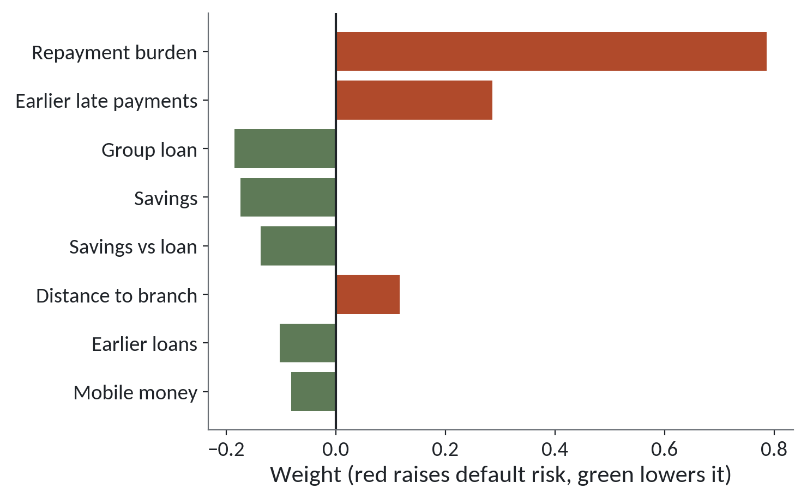
Logistic regression weights show direction and size
1
Repayment burden pushes default risk up the most.
2
Earlier late payments push it up as well.
3
Group loans and savings pull the risk down.
Standardised weights from the logistic regression. A forest has no weights like these.
Session 17 Forests, boosting and overfitting
17
Notes:
Before importance in forests, look at what the simpler model already gives you. This is the weights figure from the logistic regression, drawn without the leaked column.
Each bar is one column's weight. Red bars push the chance of default up, green bars pull it down. The longest red bar is repayment burden. The more of a borrower's income the instalment takes, the higher the risk.
Next, the earlier late payments also push risk up.
Then group loans and savings are in green. A borrower in a group, or with money saved, is less likely to default.
The chart gives a size and a direction for every column in one picture. A forest can't give you that. It has hundreds of trees and no single weight per column. For a forest we need another tool, and it comes next.

Slide 18
Feature importance by shuffling a column
from sklearn.inspection import permutation_importance
result = permutation_importance(
forest, X_test, y_test, scoring='roc_auc',
n_repeats=10, random_state=42)
imp = pd.Series(result.importances_mean, index=X.columns)
imp.sort_values(ascending=False).head(5)
1
Shuffle one column at a time, on the test part.
2
If the score drops a lot, the model leaned on that column.
3
importances_mean is the average drop over ten shuffles.
Session 17 Forests, boosting and overfitting
18
Notes:
So how do we ask a forest which columns it relied on? The tool is permutation importance. A permutation is a shuffle.
Take the test part and shuffle one column, so the values no longer belong to the right loans. Then score the model again. If the AUC falls a lot, the model leaned on that column. If it barely moves, the column wasn't doing much. Do this for each column, ten times each, and average.
It's like blanking out one column in your spreadsheet and seeing how much your forecast gets worse.
The code stores the average drop for each column in a Series, sorted from largest to smallest, and shows the top five. In a typical run, repayment burden comes near the top. Read your own list. The ranking shows size only. For direction, go back to the weights or to the data.

Slide 19
Feature importance has limits
A ranking of columns is a useful clue. Read it with three cautions.
Shared credit
Two related columns split the credit, so each looks smaller than it is.
No proof of cause
A high score says the model used the column. It does not say what changing it would do.
Today's loans only
The order can change on a new type of borrower or a new year.
Session 17 Forests, boosting and overfitting
19
Notes:
Importance scores are tempting to over read, so here are three cautions.
First, shared credit. In our loans, loan amount, income and burden are linked, because burden is built from the other two. When columns carry the same information, the credit is split between them, and each looks less important than the idea behind them really is.
Second, no proof of cause. A high score tells you the model used that column to predict. It doesn't tell you that changing the column would change anyone's behaviour. You met this with correlation in Session 4, and it still applies. Giving a borrower more savings is not the same as choosing borrowers who already have savings.
Third, today's loans only. The scores were measured on this test part. A new district, or a new year, can reorder them. So treat importance as a clue to investigate, and check it with the people who know the business.

Slide 20
When would you ship the simpler model?
Ship the simpler model
Ship the complex model
Test scores are close, within about 0.01 AUC
It wins on the test part by a gain that matters in shillings
Staff must explain each decision to a borrower
The gain holds across all five folds
A colleague must be able to rebuild it
You can monitor it and retrain it
When scores are equal, ship the simple one.
Session 17 Forests, boosting and overfitting
20
Notes:
You've built a logistic regression and a forest. Which one goes to the lender?
Start with the left side, the simple model. Ship it when the test scores are close, say within about one hundredth of AUC. Ship it when staff must explain each decision to a borrower, because a weight you can read out beats a forest you can't. And ship it when a colleague has to rebuild it six months from now, from a few lines.
On the right, the complex model. Ship it when it beats the simple one on the test part by a gain you can count in shillings. A change in the third decimal place is too small to count. Ask how many more bad loans it catches, and what each one costs. Ship it when that gain holds across all five folds, so it isn't luck. And ship it when you can monitor and retrain it, because it'll drift.
The verdict is the rule to remember. When scores are equal, ship the simple one.

Slide 21
Lab: tune a forest and decide if complexity paid
1
Open the Session 17 notebook and run the setup cell
Tool and time
Google Colab
40 minutes
2
Prepare the loans and split them 75 to 25
3
Fit a logistic regression and a default forest
You are done when
4
Compare train and test AUC, and plot depth
A table of train and test scores for each model, and a one sentence decision that names the model you would ship.
5
Tune the forest with GridSearchCV and fit a boosted model
6
List the five columns the forest leaned on
7
Write the shipping decision in one sentence
Session 17 Forests, boosting and overfitting
21
Notes:
Task one rebuilds the loan table you saw earlier, eleven columns and no collection_calls. Open the Session 17 notebook, run the setup cell, and start there. It takes forty minutes in Google Colab.
Next you fit a logistic regression and a forest, and put the train score beside the test score for each. The gap between them is your overfitting, in numbers. Then you draw the depth chart, which is the Jinja curve idea again, now with loans.
After that you tune the forest with a small grid and fit a boosted model. The grid makes forty five fits, so give it a minute. Then you list the five columns the forest leaned on.
The last step is a single sentence. Which model would you ship, and why? Did the complexity pay? Your numbers will land near the typical ones and differ a little, and every check in the notebook accepts a sensible range. If a check fails, read its message, then ask me.

Slide 22
Questions to finish
1
A model scores 0.99 on its training loans and 0.75 on its test loans. What is happening?
It is overfitting: it memorised the training loans and does not hold up on new ones.
2
How does a forest differ from boosting?
A forest grows many trees side by side and averages them. Boosting grows small trees one after another, each fixing the last one's mistakes.
3
Two models have the same test score. One is a logistic regression and one is a forest. Which do you ship?
The logistic regression. When scores are equal, the simpler model wins.
Session 17 Forests, boosting and overfitting
22
Notes:
Overfitting, forests against boosting, and one shipping decision. Three questions on those, and I'll give my answers after each.
Question one. A model scores zero point nine nine on its training loans and zero point seven five on its test loans. What's happening? Think it over.
It's overfitting. The model memorised the training loans and doesn't hold up on new ones. That gap is the sign.
Question two. How does a forest differ from boosting? Sit with it for a second.
A forest grows many trees side by side and averages their votes. Boosting grows small trees one after another, and each one fixes the mistakes of the one before.
Question three. Two models have the same test score. One is a logistic regression and one is a forest. Which do you ship? Let's hear your answer first.
The logistic regression. When the scores are equal, the simpler model wins, because it's easier to explain, check and rebuild.

Slide 23
Summary
Overfitting is a model that is great on the data it studied and weak on new data. Always show the train score beside the test score.
Forests average many trees. Boosting adds small trees that fix mistakes. Tune a few settings with cross-validation.
Importance is a clue about the model. It does not prove cause. When scores are equal, ship the simpler model.
Next session. Finding structure without labels
Session 17 Forests, boosting and overfitting
23
Notes:
One. Overfitting is a model that's great on the data it studied and weak on new data. Show the train score beside the test score every time.
Two. A forest averages many trees, and boosting adds small trees that fix mistakes. Tune a few settings with cross-validation on the learning part, and keep the test part clean.
Three. Importance is a clue and no proof of cause. And when the scores are equal, ship the simpler model.
Next session we leave the labelled loans behind. There's no default column and no right answers. We'll group Lakeside Mart customers into segments by their buying habits, and find the odd baskets. Bring a guess for how many kinds of customer a shop has.

